Slide 1

Big Data ….. ==➔ NEXUS
The nexus of mobile,
social, cloud and,
information forces will
make existing
architectures obsolete.
Un nexus est une connexion, généralement là où de multiples éléments se rencontrent.

Slide 2
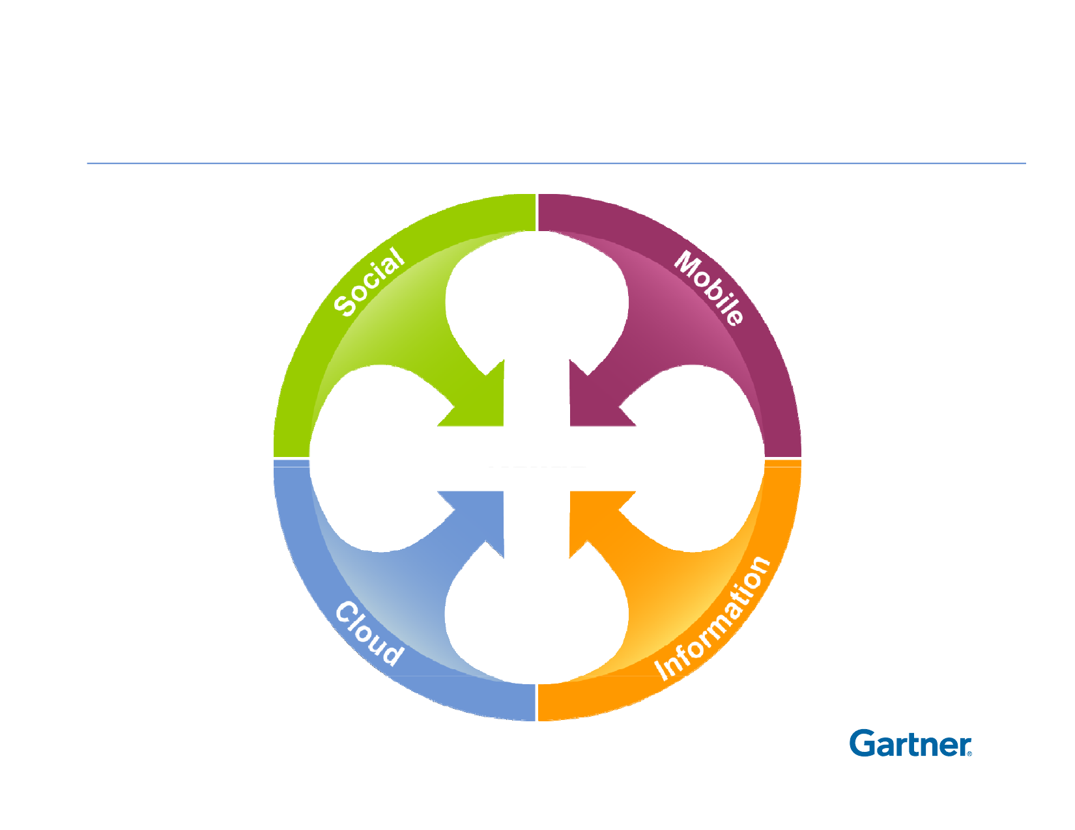
A Nexus of Forces
Big
Data

Slide 3
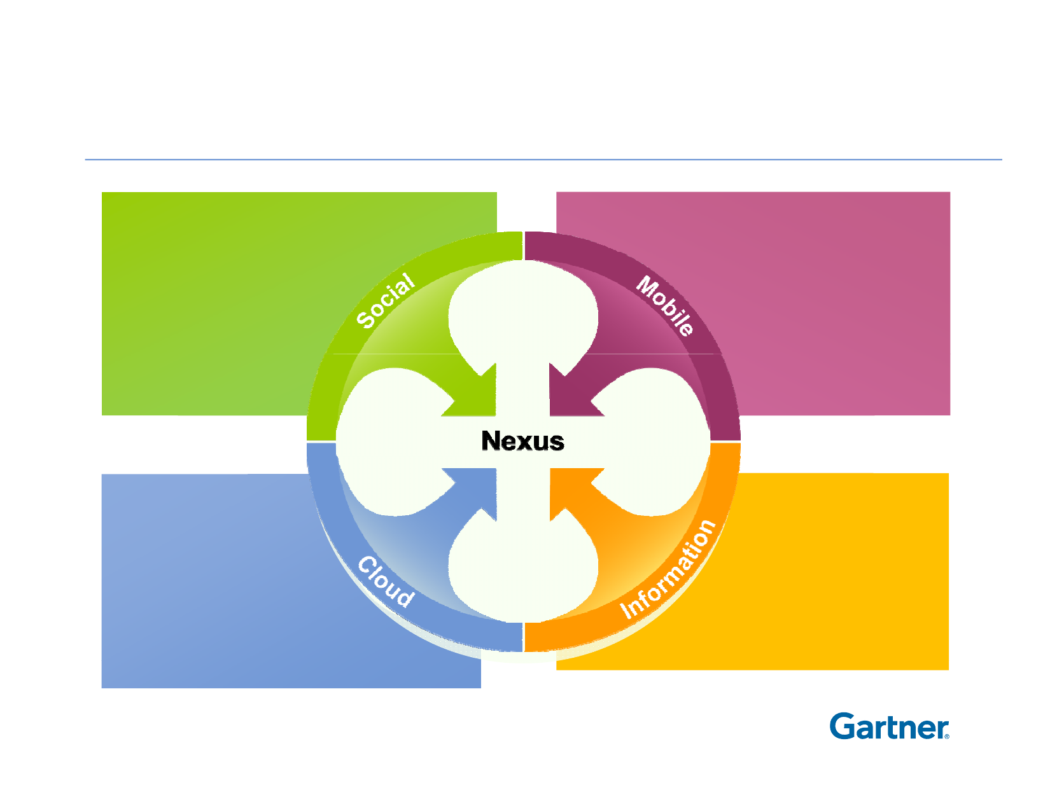
The Nexus of Disruptive Forces
Extreme
Behavior
Pervasive
Omniprésence Access
De façon dévorante
CONSUMERIZATION
Global Class
Delivery
"Big"
Context

Slide 4
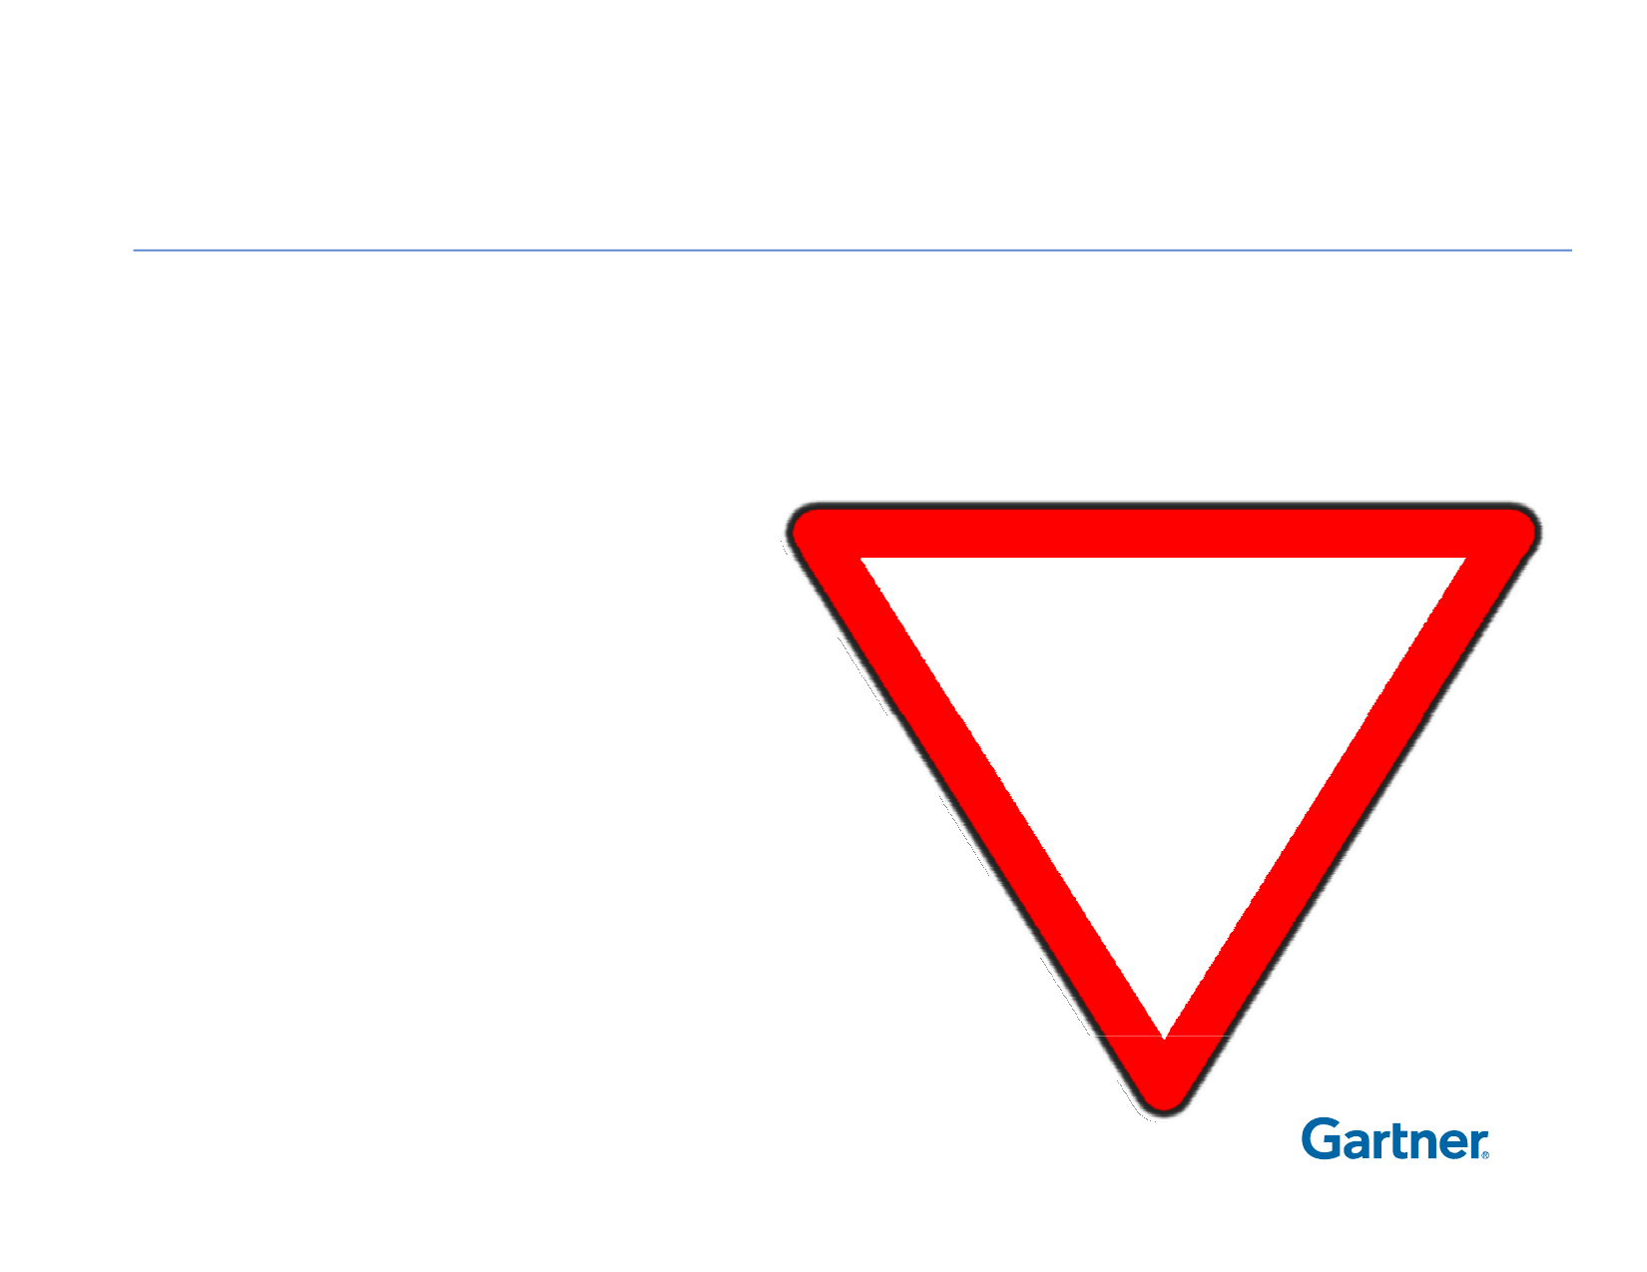
Challenges
The nexus of forces makes
✗ Existing architectures
✗ Conceived in isolation
✗ Many IT strategies
OBSOLETE
✗ Inspired from current statep
✗ Organizational structures
✗ Command and control
✗ The way IT works
✗ Specialists vs Versatilists

Slide 5
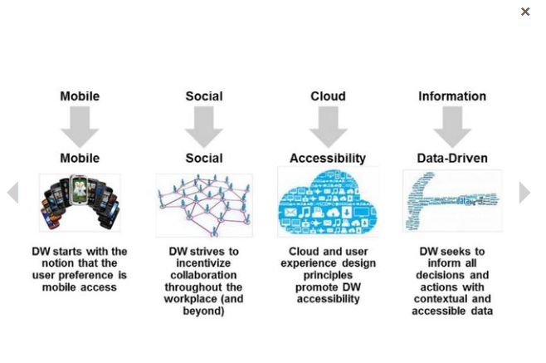

Slide 6
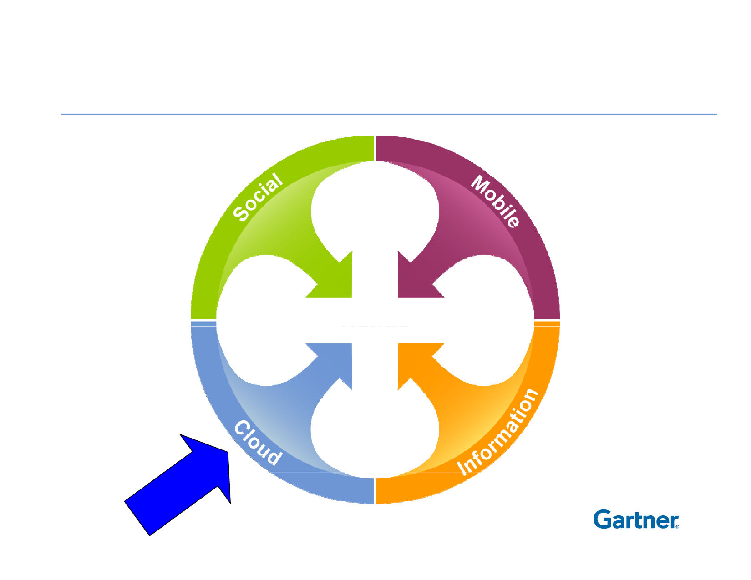
A Nexus of Forces

Slide 7
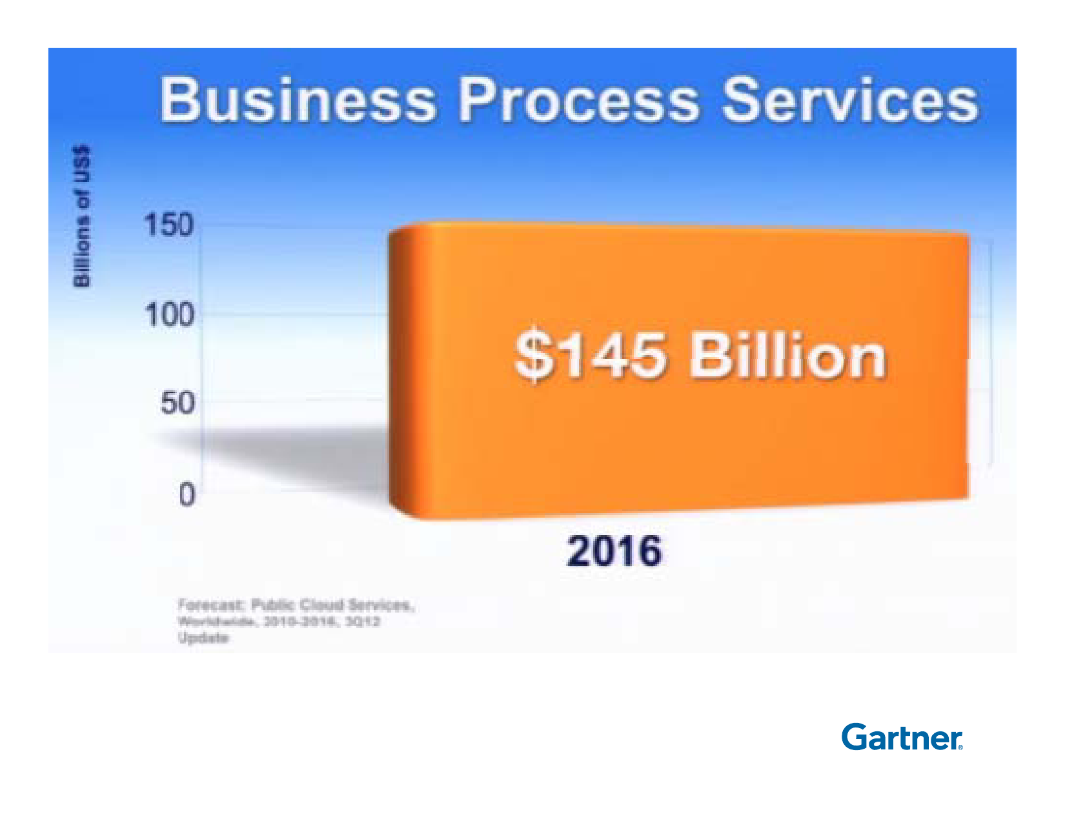
Imagine in 2023-25 ?
Armé Americaine contrat de 10 milliards
Enjeu éthique du fournisseur; Exemple Amazone

Slide 8
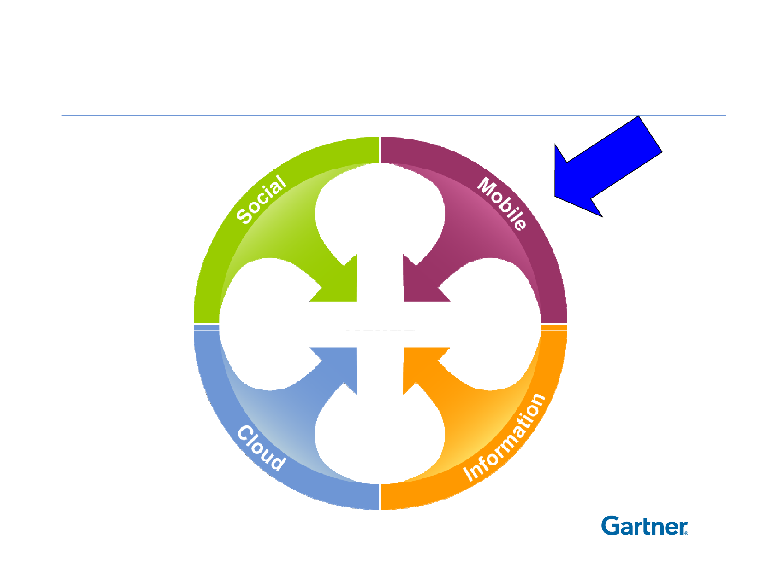
A Nexus of Forces

Slide 9
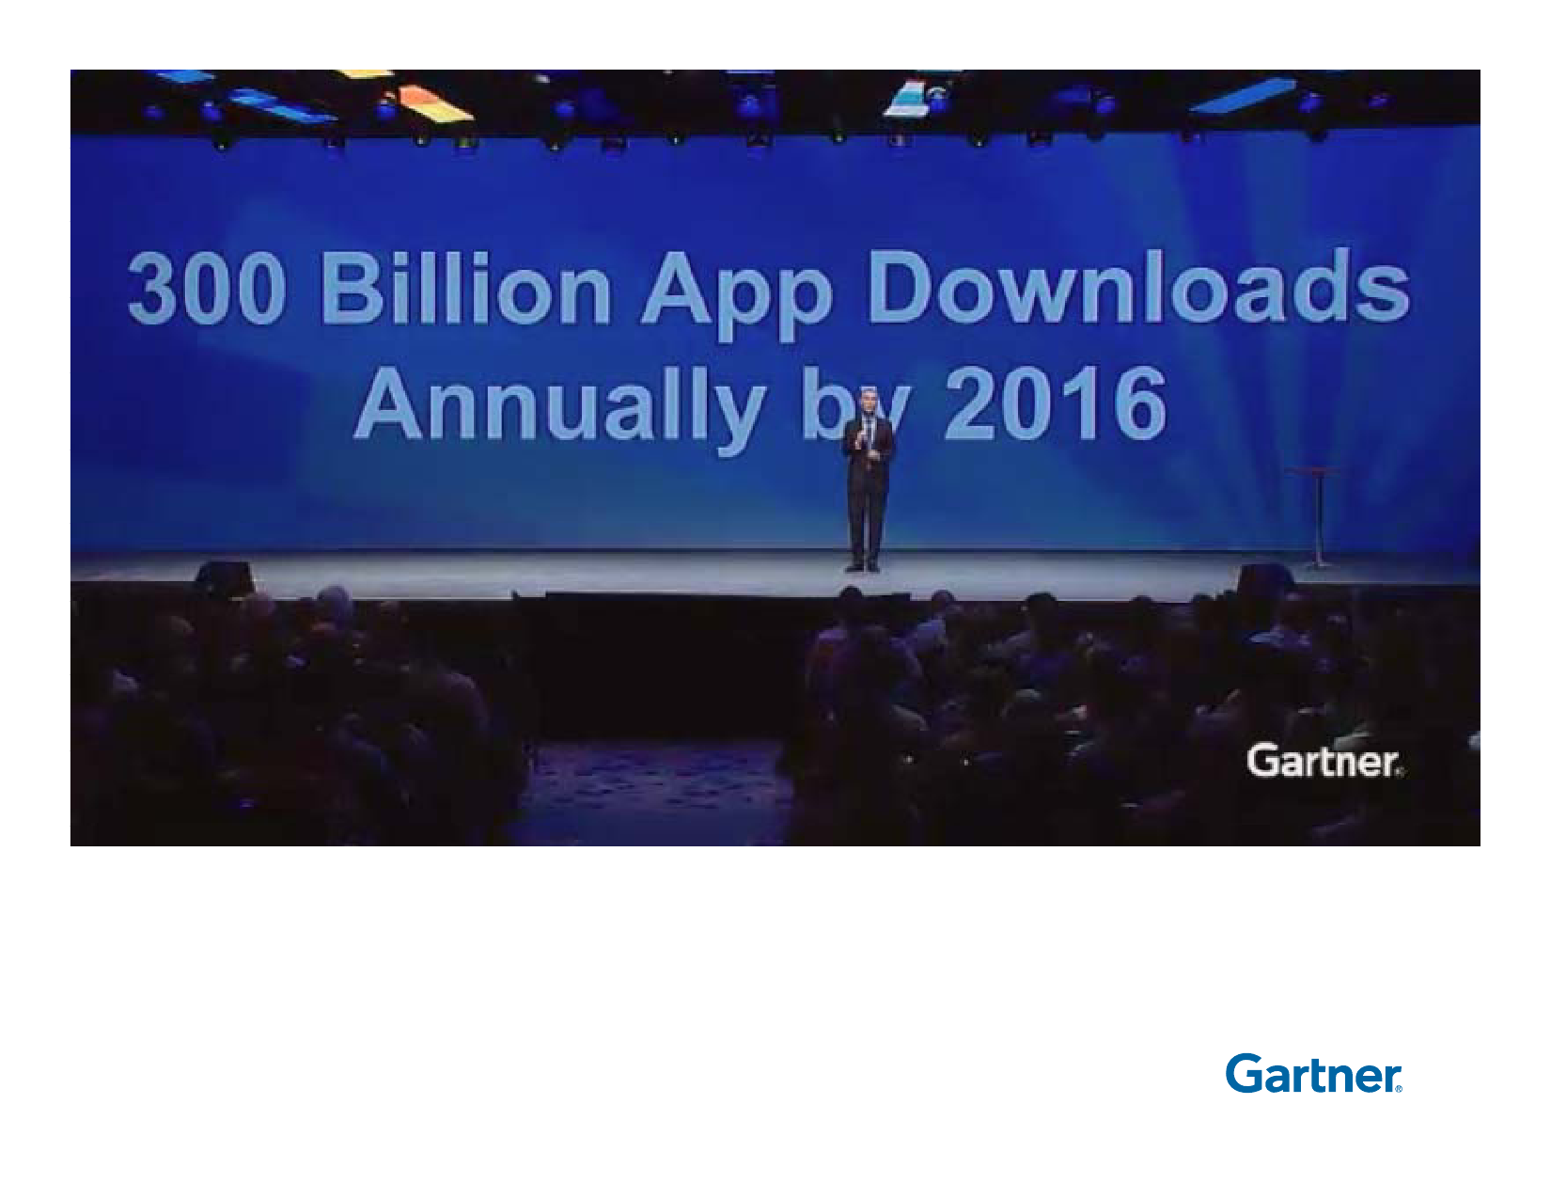
Imagine in 2023-25 ?

Slide 10
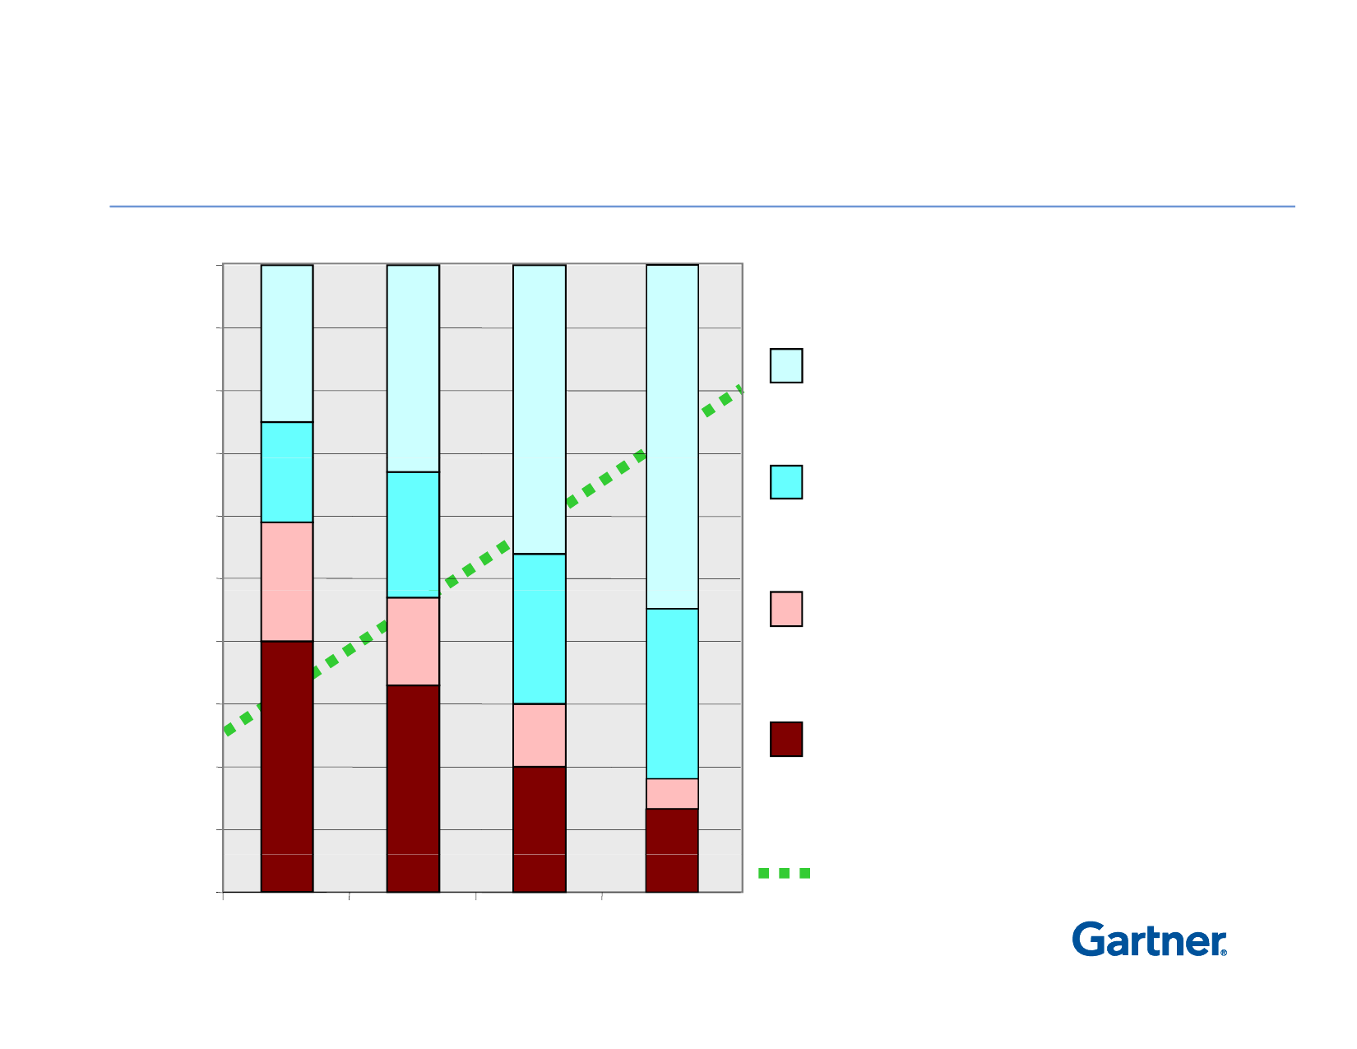
Teaming, Collaboration and Virtual Work
Become the Norms
100%
Work Modes
90%
Different time,
different place
80%
70%
Same time,Sti
different place
60%
50%
Same timetime,
same place
40%
30%
Working alone
20%
10%
Proportion of work
outcome that depends on
group input and actions
0%
2000
2005
2010
2015

Slide 11
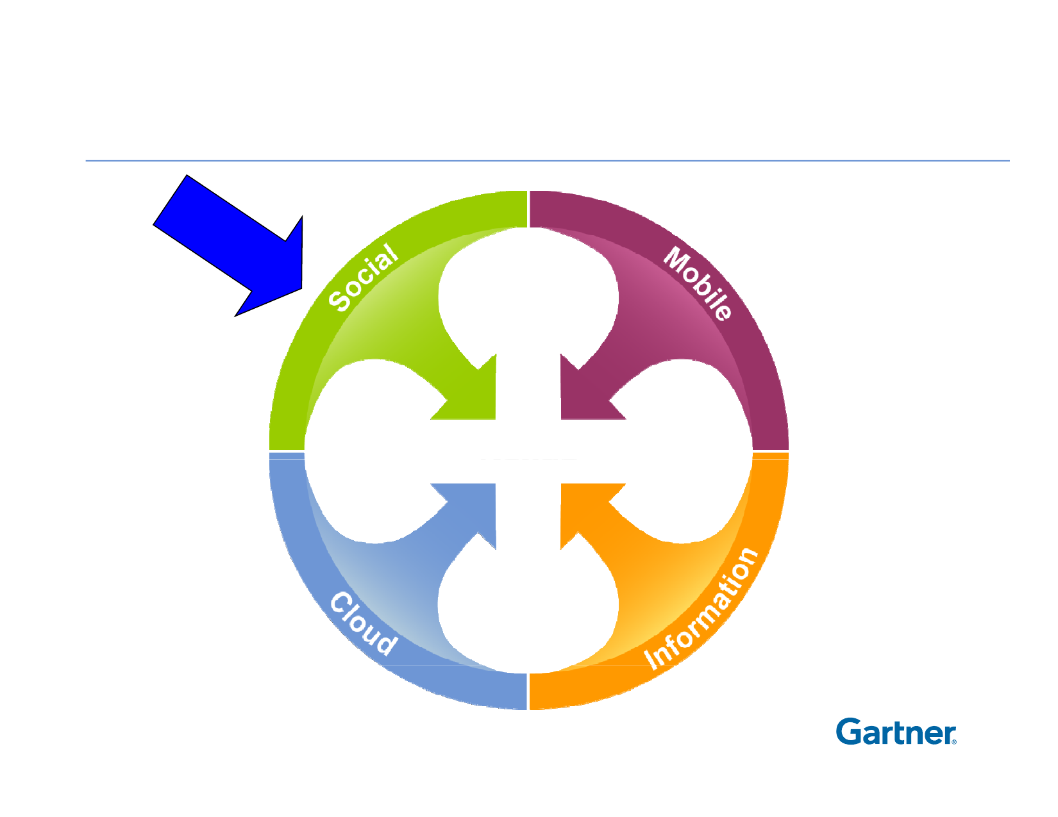
A Nexus of Forces

Slide 12
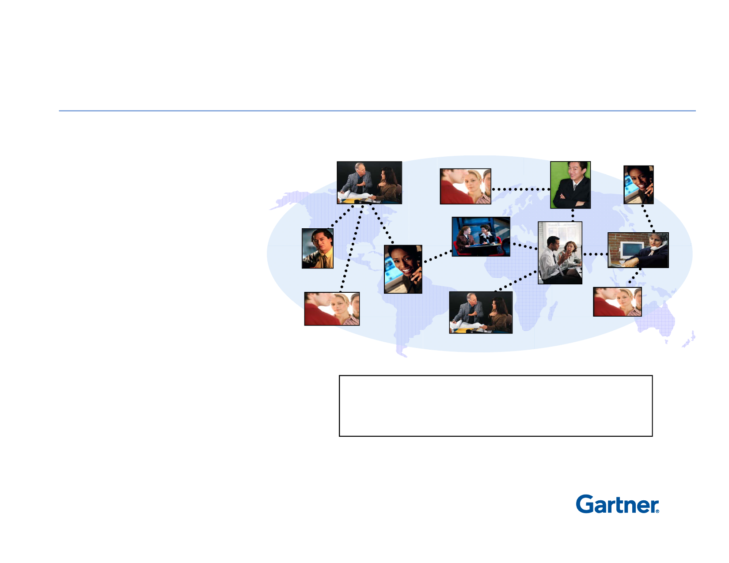
Use Digitized Social Networks
to Extend Reach, Competence, Confidence
• The Digitization
• of Social Networks
The Power of Reach and Relevance
▪ Extend the reach
for teammates
▪ Increase visibility
and profiles
▪ Improve likelihood
of response
▪ Improve the quality of collaboration
Technology extends and strengthens
social constructs, helping people to
collaborate and learn from one another.
▪ Increase confidence
in people competence
Multitudes de réseaux sociaux; FB, Shapchat, Instagram, X.

Slide 13
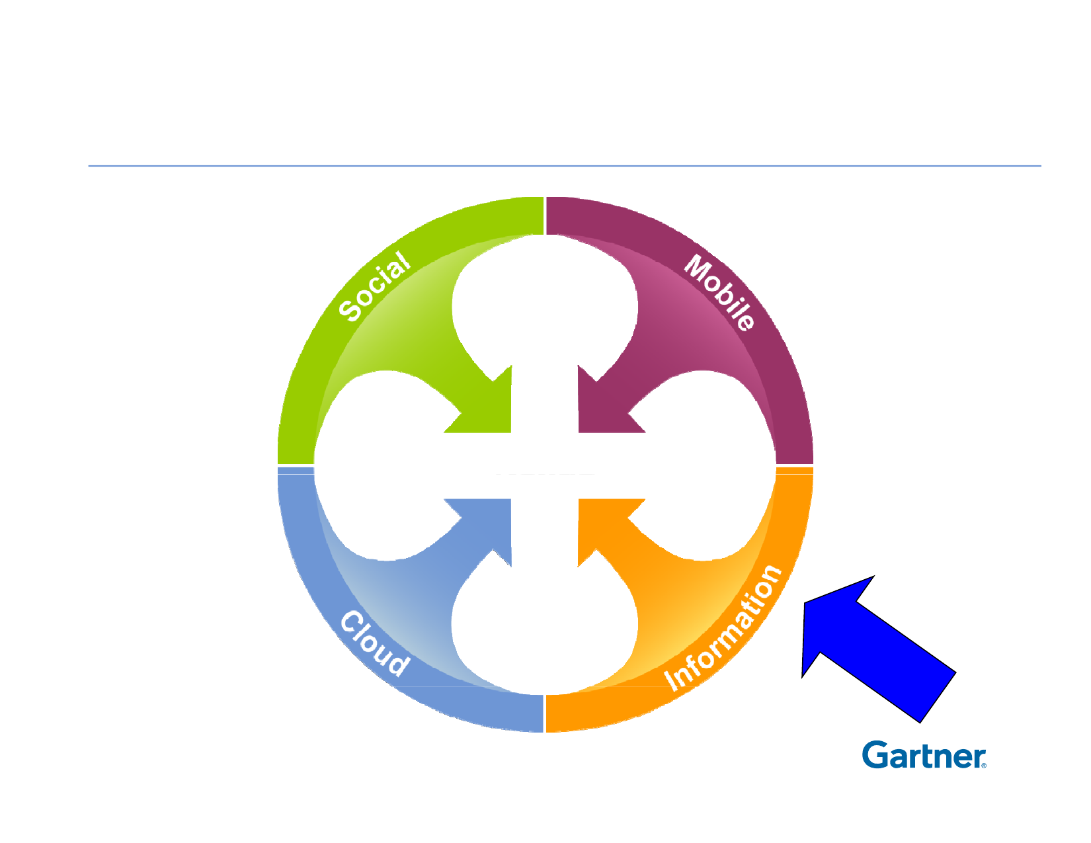
A Nexus of Forces

Slide 14
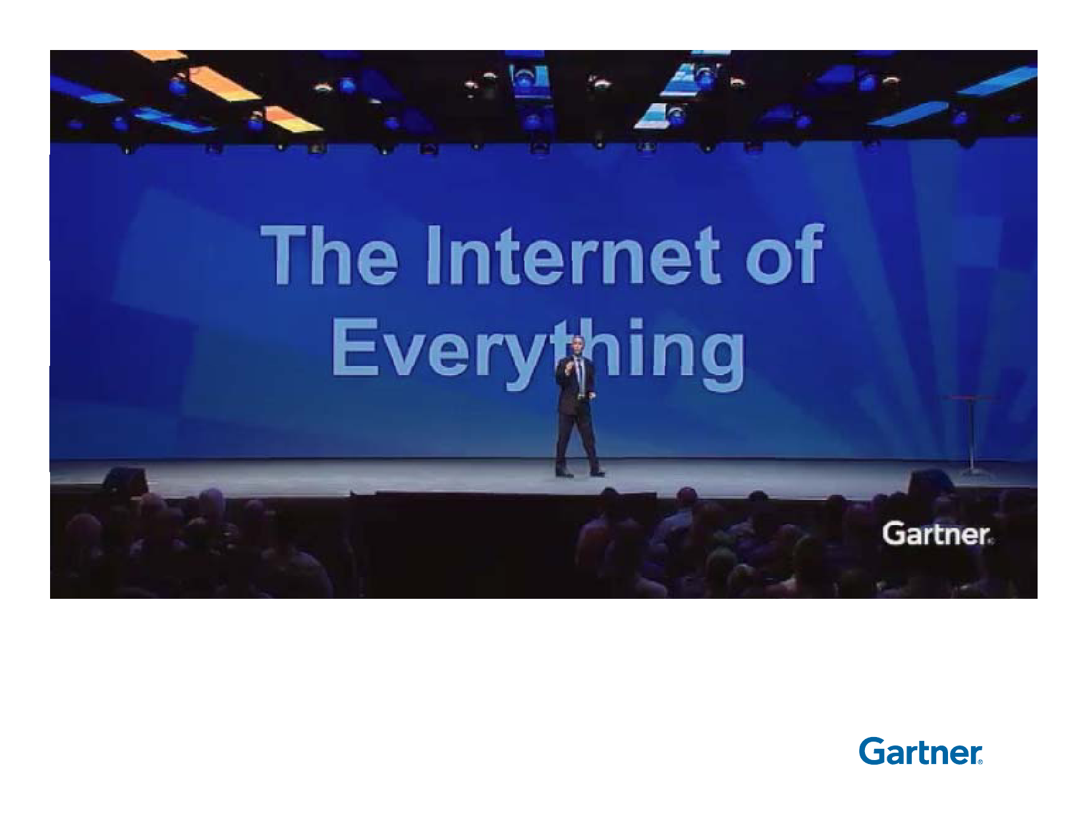

Slide 15

Thorough Analysis of Information
• From multiple sources
• Historical and real time
• Specific to an individual
• Relative to the user's
social connections
• Informed by the user's
behavioral patterns

Slide 16

Summary
1. Study your business opportunities through the nexus lens.
2. Where are you spending your time and money?
3. Reconsider how your vendor partners will help/hinder nexus
goals.
4.
5.
6.
7.
8.
9.
10.
Hire and train for the new information layer
Your individual and company brand will decide your success
Implement a modern approach to security – Openness
Technology is more than IT
What can you digitize?
How can this be monetized?
Who leads these efforts?

